Slide 1

Unemployment Insurance and The Scarring Effects of Unemployment on Employment Quality
(Additional Details)
2023 PSID Annual User Conference Kieran Blaikie

Slide 2
Background
Unemployment
Negatively affects likelihood of future employment, EQ characteristics (wages, permanency, benefits), and job match (by education, prior experience)
More prominently affects lower-paid, younger and older, and female workers. Less clear/under-studied differences by race and ethnicity
No research assessing multi-dimensional EQ, or moderation by prior EQ
Unemployment Insurance (UI)
Likely mitigates these harms, but evidence is mostly EU-based and mixed:
Across populations and contexts (e.g. by country, or in vs. not in recession)
Depending on the UI feature assessed (UI receipt, max. duration, benefit amount)
More prominently benefits those with low initial wages & wealth and less education, as well as those younger, women, and non-white

Slide 3
Study Aims
Estimate the ATT of recent unemployment on subsequent EQ
ATT (vs. ATE) as exchangeability of treated and untreated individuals unlikely
Examine whether UI features modify this effect
By UI receipt, maximum weeks receivable, maximum benefit amount
Examine modification of Aims 1 and 2
By gender, race and ethnicity, and baseline EQ
Notes:
ATT: Only assumes that the potential outcome of individuals under no treatment (Ya0) is equivalent between treated and untreated groups (i.e. Ya0 is independent of A).
ATE: Additionally requires that the potential outcome of individuals under treatment (Ya1) is equivalent between treated and untreated groups (i.e. Ya is independent of A).
It’s harder to say that people who didn’t become unemployed would have the same outcome if they were unemployed as those that did became unemployed, as there’s qualitative reasons that these people did not become unemployed (possible better performance, less underlying precarity, fewer factors contributing to their propensity for becoming unemployed). It’s easier though to say that individuals who did become unemployed would have experienced similar EQ change over time as those that didn’t, had they not became unemployed.

Slide 4
Exposure, Moderator, Outcome
Exposure (A)
Unemployment during the 12 months post-interview in T
Outcome (Y)
Z-Score Multi-Dimensional EQ Score 2+ years post-interview
UI Moderators (M)
UI receipt within 6 months of unemployment
Maximum weeks of UI receivable (< 2001-2017 State Median: No, Yes)
Maximum receivable UI amount (< 2001-2017 State Median: No, Yes)
Monthly UI amount received (unreliable reported amounts)
Notes:
17% of respondents reported greater monthly UI benefits that the maximum possible amount in their state in the quarter prior to them becoming unemployed

Slide 5
PSID Data Prep Needed for A, Y, M
PSID collects monthly data in retrospect on:
Employment status (for 24 months covering T & T+0.5 in year T+1)
UI recipiency and amount (for 12 months covering T+0.5 in year T+1)
I’d plan on using this information to determine A and M as illustrated below:
i | Interview Year (T) |  |  |  |  |  |  |  |  |  |  |  | Year+1 (T+0.5) |  |  |  |  |  |  |  |  |  |  |  | Year+2 (T+1)
 | J | F | M | A | M | J | J | A | S | O | N | D | J | F | M | A | M | J | J | A | S | O | N | D | J | F | M | A | M | J | J | A | S | O | N | D
1 |  |  |  |  |  |  |  | I |  |  |  |  | * |  |  |  |  |  |  |  |  |  |  |  |  |  |  | Y
2 |  |  | I |  |  |  |  |  |  |  |  |  |  |  |  |  |  |  |  |  |  |  |  |  |  |  |  |  |  |  | Y
3 |  |  |  |  |  | I |  |  |  | * |  |  |  |  |  |  |  |  |  |  |  |  |  |  |  | Y
4 |  |  |  |  |  |  |  |  |  |  | I |  |  |  |  |  |  |  |  |  | * |  |  |  |  |  |  |  |  |  |  |  |  | Y
I: Interview month at T. Green: Unemployment within 12-months post-I. *: First Unemployment. Orange: UI receipt within 6 months post-unemployment. Dashed Orange: Months in which UI recipiency information was not collected.
Y: EQ at subsequent interview T+1.

Slide 6
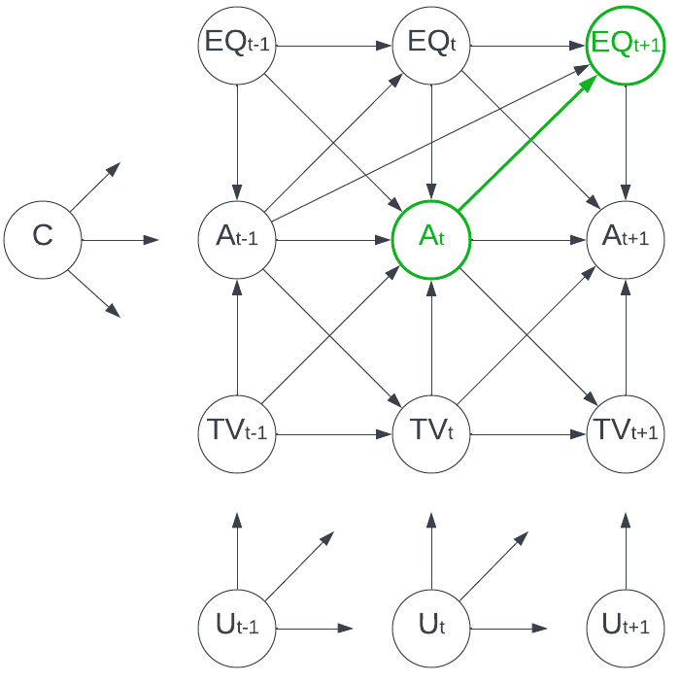
Assumed Unemployment → EQ Relationship
DAG Legend
t | Time index (none = fixed)
C | Baseline covariates
A | Unemployment Status (exposure)
EQ | Current/most recent job EQ (outcome)
TV | Measured time-varying covariates
U | Unmeasured time-varying covariates
Notes
C is assumed to affect everything, and includes measured and unmeasured factors
U_{t} is assumed to affect everything at t, t+1
UI at t is expected to modify ATT(A_{t} → EQ_{t+1})

Slide 7
Assumed Unemployment → EQ Relationship
Assumed/Implied Causal Features
Unmeasured unit- and time-FE
Time-varying confounding
Exposure-outcome feedback
Multiple time-points t
Exposure possible at any t
Exposure-switching over time
Lagged exposure effects
Markov-1 assumption (M-2 for A)

Slide 8
How can we estimate this ATT?
Methods Used In Existing Research
Most studies around scarring effects and UI moderation have used:
Differences-in-differences (DiD) approaches
Individual and two-way fixed effects approaches
Regression discontinuity
Structural Equation Modelling (SEMs)
Propensity Score matching techniques
These often exploit natural experiments where: 1) a single threshold defines exposure status (e.g. time, age), or 2) individuals transition from unexposed to exposed once.
In our assumed causal scenario, each methods would be violated in 1+ way.

Slide 9
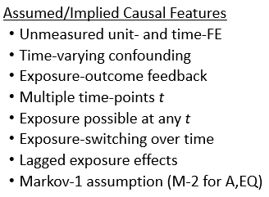
How can we estimate this ATT?
Implemented Approach
Imai, Kim & Wang (2021) propose a semi-parametric two-way fixed effect estimator which allows for each of the causal features in our study (below right)
The standard TWFE estimator can’t work in our scenario unless we assume across units either:
The within-unit causal effect is constant, or
The frequency of ‘exposure’ is constant
Both of which seem unreasonable where we expect social modification of effects.

Slide 10
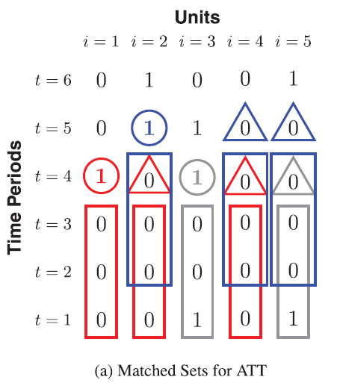
How can we estimate this ATT?
Implemented Approach
The proposed two-way fixed effect estimator works as follows:
Create a matched set M_{it} for each newly exposed observation (i,t) with all unexposed observations (i’,t) with the same exposure history up to some lag L (e.g. 3 time-points)

Slide 11
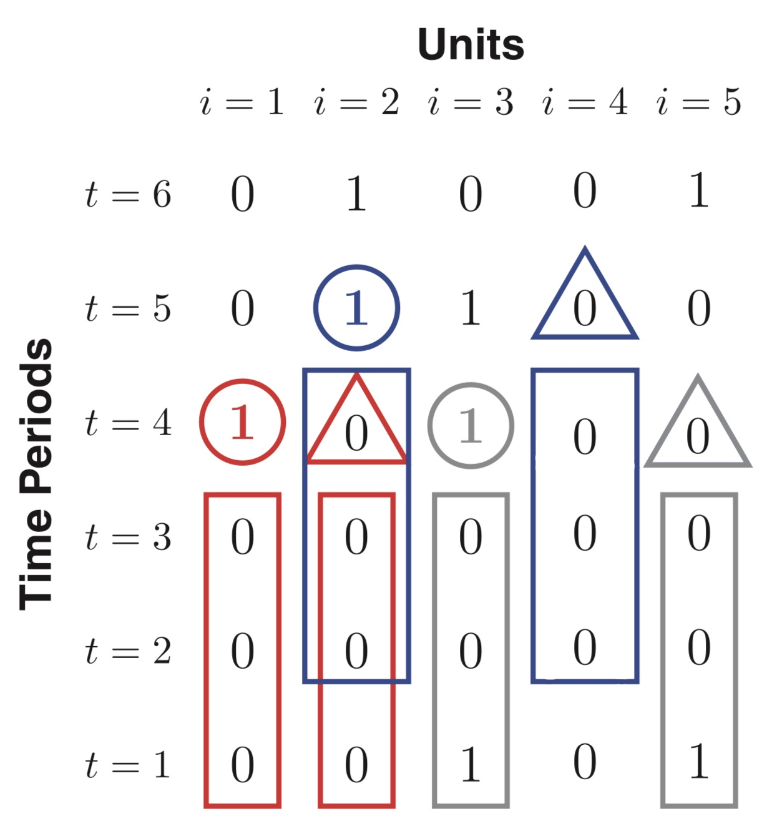
How can we estimate this ATT?
Implemented Approach
The proposed two-way fixed effect estimator works as follows:
Create a refined matched set R_{it} from M_{it} for each newly exposed observation, restricting to the set of unexposed observations with the most similar covariate histories based on, e.g.:
Mahalanobis distance
Propensity scores (Implemented)
Inverse Probability Weights

Slide 12
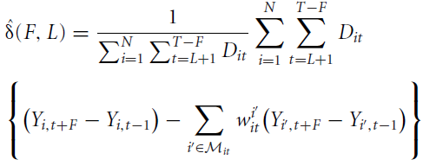
How can we estimate this ATT?
Implemented Approach
The proposed two-way fixed effect estimator works as follows:
Employ a DiD estimator (bottom) to estimate our causal effect of interest, weighting each matched set-specific ATT_{it} estimate via D_{it} based on how often that exposed unit i contributes to the analysis.
The DiD estimator compares:
Pre-post outcome difference in the newly exposed observation
Weighted average pre-post outcome differences across matched unexposed observations
This DiD estimator is equivalent to a weighted linear two-way fixed effect estimator, weighting each observation in a way that accounts for matching
Notes:
W_{it}^{i’} = Another weight for each control observation in a given matched set, where more-similar control observations are weighted more strongly and the sum of all control observation weights in a set equal 1.

Slide 13
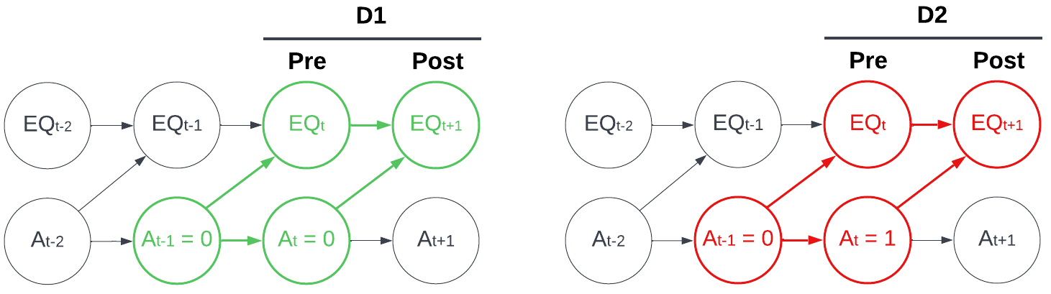
Accounting for Structural Outcome Missingness
We want to estimate ATT(A_{t} → EQ_{t+1}) using a DiD-based approach with:
D1: Outcomes at t and t+1 among those remaining employed (A_{t-1} = 0, A_{t} = 0), vs.
D2: Outcomes at t and t+1 among those becoming unemployed (A_{t-1} = 0, A_{t} = 1)
We assume A at t-1 affects EQ at t, so ideally compare EQ at t and t+1.

Slide 14
Accounting for Structural Outcome Missingness
Respondents unemployed at t have no EQ though (since they’re unemployed), so we cannot use this EQ measure as ‘post-exposure EQ’ for (i,t-1) or ‘baseline EQ’ for (i,t+1).
We always want:
Baseline EQ to always precede post-exposure EQ
Post-exposure EQ to be from a subsequent wave to t if (i,t) is used as a ‘post’ observation in a DiD comparison
To accommodate this, we assign ‘pre’ and ‘post’ EQ for each participant at each time t from neighbouring interviews under each of the below conditions:
A_{t-1} , A_{t} , A_{t+1} | t used as ‘post’ in DiD? | ‘Pre’ EQ (t) | ‘Post’ EQ (t+1)
0, 0, 0 | Yes | Most recent ≤ t | Nearest subsequent > t
0, 1, A | Yes | Most recent ≤ t | Nearest subsequent > t
0, 0, 1 | Sometimes | Second most recent ≤ t | Most recent ≤ t
1, A, A | No | Second most recent ≤ t | Most recent ≤ t

Slide 15
Explanations and Planned Sanity Checks for Counter-Intuitive Findings
Selection on reported EQ (if employed) & covariates skewing sample?
Repeat analyses after multiple imputation
Different lags and leads for pre- and post-exposure EQ?
Restrict to those with EQ ≤ 4 years from pre- and post-observations, which may itself be a lesser issue post-imputation
Unaccounted-for time-varying confounding?
Explore other covariates (e.g. past-quarter state unemployment, GPD/capita)
Different lengths of unemployment pre-re-employment?
Calculate (where possible) and stratify by
Possible source-specific issue related to retrospective exposure and moderator ascertainment and biennial outcome measurement?
Explore replication of study in different data source (Not Going to Do)
Notes:
Sanity Check 1:
Multiple Imputation is implemented
Sanity Check 2:
For the consistently employed:
‘Baseline’ EQ comes from current wave t in 82% of observations.
‘Subsequent’ EQ comes from ≤4 years of t in 95% of observations.
For those recently unemployed:
‘Baseline’ EQ comes from current wave t in 81% of observations.
‘Subsequent’ EQ comes from ≤4 years of t in 95% of cases
Sanity Check 3:
We now account for past-quarter state unemployment rate and real GSP per capita as state-level covariates.
Sanity Check 4:
We account for length of unemployment prior to current wave t in the matching process, and conduct stratified analyses by length of unemployment until re-employment post-t.
Possible Next Steps
Look at Stacked DiD and conventional FE
Could a further matching step based on propensity for UI receipt (without considering unemployment status) account for possibly differential comparability between continuously employed ‘unexposed’ units and UI-receiving and UI-not-receiving unemployed ‘exposed’ units?

Slide 16
Accounting for Random Covariate Missingness
31% of observations were incomplete across analytic variables.
We accounted for this using multiple imputation, where we:
Create 35 multiply imputed datasets following guidance from White et al. (2011), who recommend creating at least as many imputed datasets as the percentage of incomplete cases.
Conduct MI within employment strata before re-merging strata post-imputation to best-follow guidance from Sullivan et al. (2018), who recommend conducting MI within exposure strata.
Some variables (e.g. UI receipt) are structurally implausible for those consistently employed, so we do not impute these variables in MI models for those ‘unexposed’.
Cluster imputations by individual when imputing our exposure and outcome.
Notes:
White IR, Royston P, Wood AM. Multiple imputation using chained equations: issues and guidance for practice. Stat Med. 2011;30:377–399. 73.
Sullivan TR, White IR, Salter AB, Ryan P, Lee KJ. Should multiple imputation be the method of choice for handling missing data in randomized trials? Stat Methods Med Res. 2018;27:2610–2626.

Slide 17
Study Eligibility Restrictions
We restrict the available sample of observations as below:
Between 2003 and 2017
Aged 18-64 years old
Attached to the labor market (employed/temp. laid-off, or unemployed)
Not self-employed
With known race, ethnicity, gender, nativity, and childhood SES
With three consecutive waves in which exposure and outcome status are known
With respondents living in the same state over those 3 consecutive waves

Slide 18
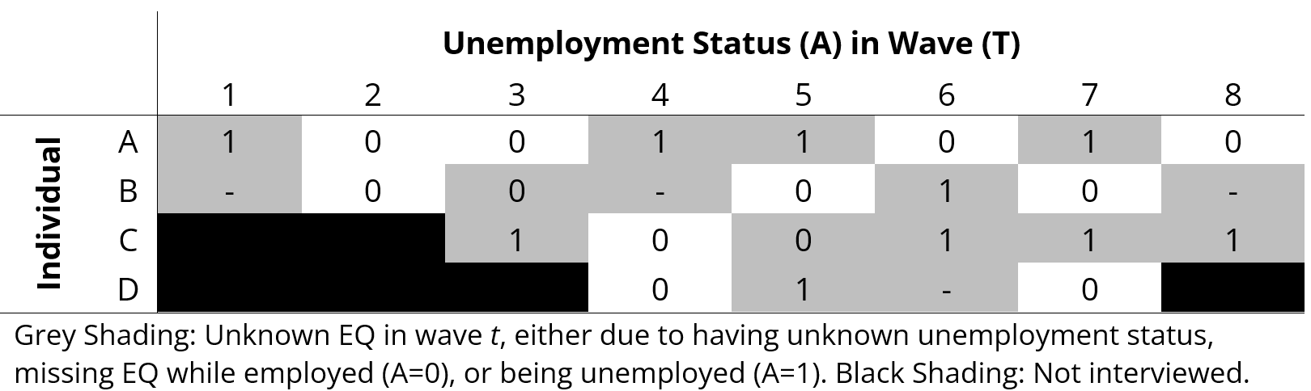
Analytic Sample Development Example
We develop our analytic sample in the following steps:
Identify the maximum sample per participant where participants are in-theory eligible (e.g. by year, age, labor market attachment).

Slide 19
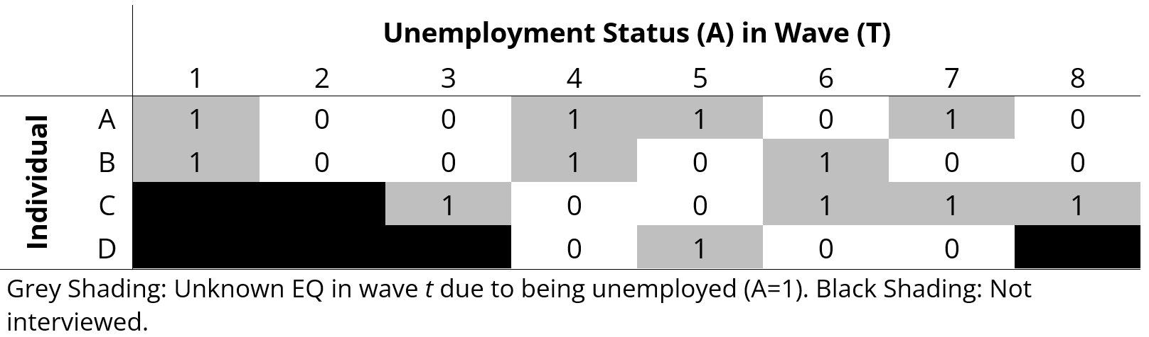
Analytic Sample Development Example
We develop our analytic sample in the following steps:
Use multiple imputation N times (one shown) to impute unemployment status and EQ variables (among others) where missing.

Slide 20
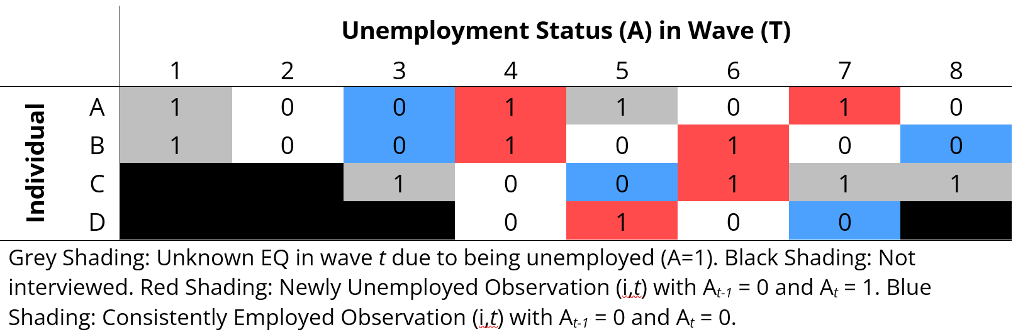
Analytic Sample Development Example
We develop our analytic sample in the following steps:
Identify observations ‘newly unemployed’ (red) and ‘consistently employed’ (blue) based on A_{t-1} and A_{t}.

Slide 21
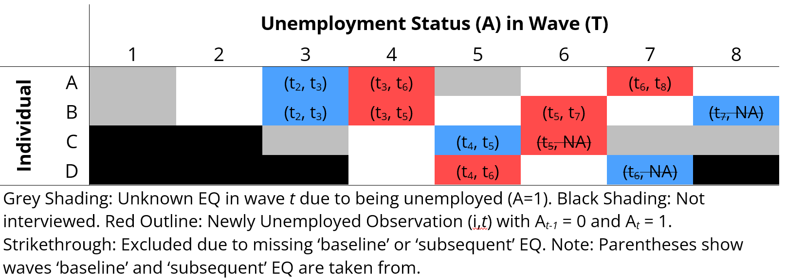
Analytic Sample Development Example
We develop our analytic sample in the following steps:
Determine ‘pre’ (baseline) and ‘post’ (subsequent) EQ for all wave observations (only highlighting ATT analysis observations here) following the structural outcome missingness solution discussed previously.

Slide 22
Study Characteristics
Data: 1984-2019 PSID Data (Analysis Years: 2003-2017)
Analysis N: 8752 individuals, 45,193 observations (Mean Follow-Up: 6.6 Years)
Characteristic |  | Sample
 |  | Complete Case |  | MI Dataset Averages
 |  | Consistently Employed | Recently Unemployed | Consistently Employed | Recently Unemployed
N Individuals (Observations) |  | 6677 (22,963) | 3080 (3537) | 6934 (24,226) | 3431 (3969)
Age | Mean (SD) | 43.2 (10.0) | 38.4 (10.1) | 43.2 (10.0) | 38.4 (10.2)
Gender (%)* | Male | 3151 (47) | 1478 (48) | 3276 (47) | 1626 (47)
Race and Ethnicity (%)* | NH White | 3984 (54) | 1781 (53) | 4098 (54) | 1942 (51)
 | NH Black | 1982 (30) | 981 (32) | 2092 (30) | 1122 (33)
 | NH Other | 534 (8) | 231 (8) | 555 (8) | 261 (8)
 | Hispanic | 544 (8) | 246 (8) | 575 (8) | 287 (8)
Baseline EQ | Mean (SD), NA | 0.14 (0.37), 241 | -0.03 (0.42), 70 | 0.13 (0.40), 51 | -0.06 (0.46), 29
Pre-Post EQ Change | Mean (SD), NA | 0.34 (0.48), 241 | -0.39 (0.86), 70 | 0.32 (0.54), 51 | -0.33 (0.88), 29
UI Receipt (%), NA | Yes | - | 353 (13), 810 | - | 508 (13), 0
* Counts and percentages reflect characteristics of unique individuals, excluding repeated measurements.
Notes:
Important Note:
Our UI modification results cannot be interpreted as the causal modifying effect of UI receipt on the ATT of unemployment on later EQ, as we do not establish exchangeability between cohorts receiving and not receiving UI benefits.
For example, compared to those becoming unemployed and not receiving UI, those receiving UI are:
Approximately as likely male (49% vs. 47%).
More often NH Black (35% vs. 32%), NH Other (13% vs. 7%), and Hispanic (13% vs. 8%), and less often NH White (58% vs. 49%).
More often non-native to the US (9% vs. 6%).
More often from a low SES upbringing (25% vs. 22%).
Had comparable baseline EQ before unemployment (Mean: -0.07 vs. -0.06).
Less often married (67% vs. 65%).
More often had less than high school education (16% vs. 12%) and less often had college or more education (20% vs. 29%).
Less often in very good or excellent health (54% vs. 60%).
Had marginally lower family income (Mean: -0.06 vs. -0.04), but greater family wealth excluding home equity (Mean: 65K vs. 60K).
Were more often at baseline in occupations related to farming, forestry or fishing (2.5% vs. 1.4%), managerial roles (10.1% vs. 8.9%), and technical support or admin (32.8% vs. 28.4%).
Other Points:
Those receiving UI remain unemployed for slightly longer on average than those not receiving UI (Mean (SD): No UI – 10.1 months (7.4), Yes UI – 11.4 months (8.1)).
Contrasting how groups change occupational sectors from ‘baseline’ to next employment via pre-post occupational sector absolute % changes:
Those consistently employed do not appreciably change sectors (Mean Absolute Change: 0.11%, SD: 0.12).
Those recently unemployed and not receiving UI change sectors more (Mean Absolute Change: 0.30%, SD: 0.30).
Those recently unemployed and receiving UI change sectors the most (Mean Absolute Change: 0.99%, SD: 0.81).
Contrasting these shifts in terms of the average EQ in sectors changed between:
Those consistently employed transition slightly into sectors with better EQ (Weighted Attributable Shift in Mean EQ: -0.001)
Those recently unemployed and not receiving UI transition slightly into sectors with worse EQ (Weighted Attributable Shift in Mean EQ: -0.002)
Those recently unemployed and receiving UI transition into sectors with even worse EQ, though still to a small extent (Weighted Attributable Shift in Mean EQ: -0.007)

Slide 23
Study Characteristics
Matching by year and state over {t-2,t-1,t} and employment over {t-2, t-1}, there were:
Pooled Average Characteristics Across Multiply Imputed Dataset Analyses
Observation Group | All | UI Receipt
Observation Group | All | No | Yes | < Med. Max Dur. | ≥ Med. Max Dur. | < Med. Max Ben. | ≥ Med. Max Ben.
Matched Exposed (N) | 2581 | 2236 | 346 | 8 | 338 | 139 | 212
Unmatched Exposed (N) | 657 | - | - | - | - | - | -
Matched Unexposed Per Exposed (Median N [IQR]) | 40 [7, 104] | 74 [20, 112] | 86 [28, 116] | 84 [49, 93] | 86 [28, 116] | 77 [21, 101] | 90 [37, 129]
PS matching approaches also consider covariate history. Set sizes shown are pre-refinement, with all sets restricted to the 10 most-similar unexposed units per exposed unit after refinement. Maximum UI duration and benefit amount are state-level factors, not reflective of the duration and benefit received. 2001-2017 Median State Maximum UI Duration: 26 weeks. 2001-2017 Median State Maximum UI Benefit for those with dependents: $390/week.

Slide 24
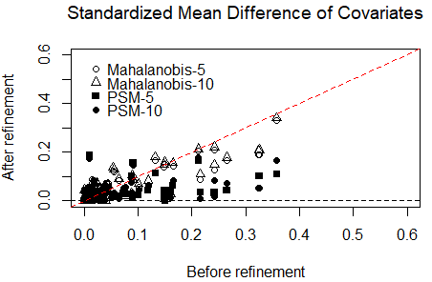
Matched Set Covariate Balance
We determined which refinement approach to use and the and number of unexposed observations per exposed observation to include in refined sets by examining which combination provided the best within-set covariate balance between exposed and exposed observations. From this, chose propensity score matching (PSM) with up to 10 unexposed observations per ‘newly exposed’ observation.

Slide 25
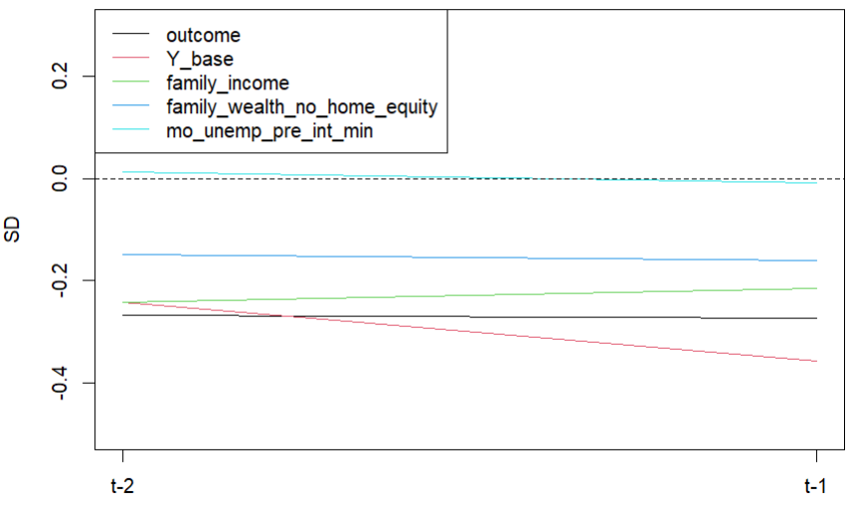
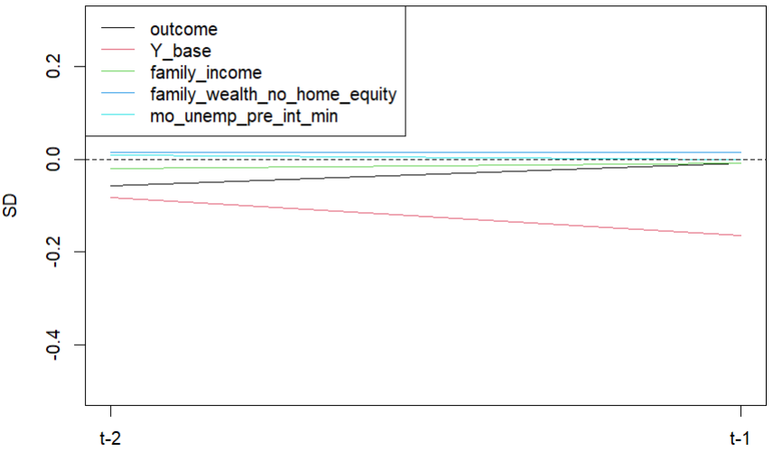
Parallel Trends Assumption Pre-Post Refining
We rely on the parallel trends assumption pre-exposure. Below shows the standardized deviation in mean covariate differences between newly unemployed and consistently employed observations over time for continuous variables (family income, family wealth, months unemployed pre-interview, baseline EQ, and subsequent EQ). We observe small differences between exposure groups before and after refinement, with better balance after refinement.
Pre-Refinement
Post-Refinement
Notes:
Want to work out traditional outcome parallel trends figure (instead of outcome SD figures)

Slide 26
Preliminary Results (Complete Case)
Overall
Comparing two populations matching in 4-year employment history, the ATT of becoming unemployed on earliest subsequent EQ when re-employed is:
Exposed Group |  | ATT/CATT | SE | Bootstrap 95% CI
All unemployed |  | -0.61 | 0.02 | -0.65, -0.57
UI Category | No UI | -0.44 | 0.02 | -0.49, -0.39
 | UI (Any) | -1.14 | 0.08 | -1.29, -0.98
 | UI (< Median Max Dur.) | -1.29 | 0.40 | -2.18, -0.68
 | UI (≥ Median Max Dur.) | -1.13 | 0.08 | -1.28, -0.99
 | UI (< Median Max Ben.) | -1.11 | 0.14 | -1.39, -0.85
 | UI (≥ Median Max Ben.) | -1.16 | 0.09 | -1.34, -0.97
Median Maximum Duration: 26 weeks. Median Maximum Benefit with Dependents: $390/week.

Slide 27
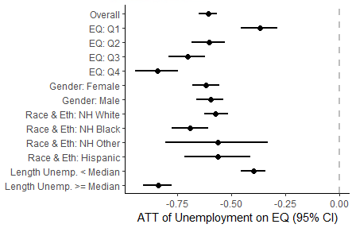
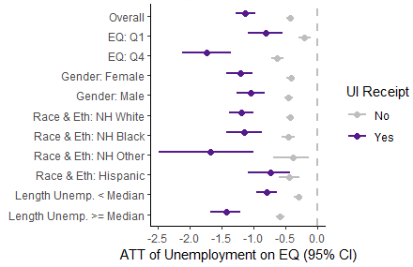
Preliminary Results (Complete Case)
Comparing Subpopulations
Comparing two populations matching in 4-year employment history, the ATT of becoming unemployed on earliest subsequent EQ when re-employed is:
Scarring Effects
UI Modification

Slide 28
Preliminary Results (Multiply Imputed)
Overall
Comparing two populations matching in 4-year employment history, the ATT of becoming unemployed on earliest subsequent EQ when re-employed is:
Exposed Group |  | Pooled ATT | Pooled SE | Pooled 95% CI
All unemployed |  | -0.56 | 0.02 | -0.61, -0.52
UI Category | No UI | -0.51 | 0.02 | -0.55, -0.46
 | UI (Any) | -0.94 | 0.07 | -1.08, -0.81
 | UI (< Median Max Dur.) | -0.82 | 0.44 | -1.68, 0.03
 | UI (≥ Median Max Dur.) | -0.95 | 0.07 | -1.09, -0.81
 | UI (< Median Max Ben.) | -0.83 | 0.12 | -1.08, -0.59
 | UI (≥ Median Max Ben.) | -1.01 | 0.09 | -1.18, -0.84
Median Maximum Duration: 26 weeks. Median Maximum Benefit with Dependents: $390/week.

Slide 29
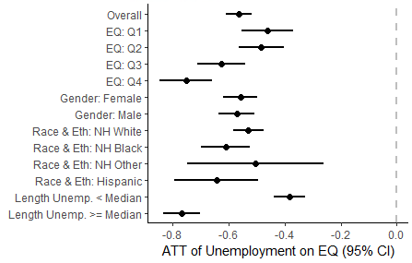
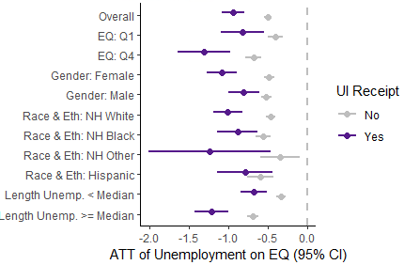
Preliminary Results (Multiply Imputed)
Comparing Subpopulations
Comparing two populations matching in 4-year employment history, the ATT of becoming unemployed on earliest subsequent EQ when re-employed is:
Scarring Effects
UI Modification

Slide 30
Preliminary Conclusions
Scarring Effects
Becoming unemployed causes significant declines in multi-dimensional EQ upon re-employment.
These effects are more pronounced for those with better initial EQ, those non-Hispanic Black or Hispanic, and those remaining unemployed for longer, though scarring effects do not vary considerably by gender overall.
Modification of Scarring Effects by Unemployment Insurance Receipt
The effects of becoming unemployed on subsequent EQ are more detrimental for those receiving UI, especially for recipients in states with longer-lasting and more generous UI policies.
The negative modification associated with UI receipt appears greatest for those with better initial EQ, for men, for those non-Hispanic white or non-Hispanic and not white or Black (i.e. ‘other’), and for those remaining unemployed for longer.
Selection Effects in a Complete-Case Analysis
Relying on a complete-case analysis would have minimized the estimated scarring effects experienced for those Hispanic, and suggested scarring effects are more detrimental for those receiving UI in states with shorter-lasting UI policies, though would not have inferentially changed other findings.
Notes:
Important Note:
Our UI modification results cannot be interpreted as the causal modifying effect of UI receipt on the ATT of unemployment on later EQ, as we do not establish exchangeability between cohorts receiving and not receiving UI benefits.
For example, compared to those becoming unemployed and not receiving UI, those receiving UI are:
Approximately as likely male (49% vs. 47%).
More often NH Black (35% vs. 32%), NH Other (13% vs. 7%), and Hispanic (13% vs. 8%), and less often NH White (58% vs. 49%).
More often non-native to the US (9% vs. 6%).
More often from a low SES upbringing (25% vs. 22%).
Had comparable baseline EQ before unemployment (Mean: -0.07 vs. -0.06).
Were less often married (67% vs. 65%).
More often had less than high school education (16% vs. 12%) and less often had college or more education (20% vs. 29%).
Were less often in very good or excellent health (54% vs. 50%).
Had marginally lower family income (Mean: -0.06 vs. -0.04), but greater family wealth excluding home equity (Mean: 65K vs. 60K).
Were more often at baseline in occupations related to farming, forestry or fishing (2.5% vs. 1.4%), managerial roles (10.1% vs. 8.9%), and technical support or admin (32.8% vs. 28.4%).
Other Points:
Those receiving UI remain unemployed for slightly longer on average than those not receiving UI (Mean (SD): No UI – 10.1 months (7.4), Yes UI – 11.4 months (8.1)).
Contrasting how groups change occupational sectors from ‘baseline’ to next employment via pre-post occupational sector absolute % changes:
Those consistently employed do not appreciably change sectors (Mean Absolute Change: 0.11%, SD: 0.12).
Those recently unemployed and not receiving UI change sectors more (Mean Absolute Change: 0.30%, SD: 0.30).
Those recently unemployed and receiving UI change sectors the most (Mean Absolute Change: 0.99%, SD: 0.81).
Contrasting these shifts in terms of the average EQ in sectors changed between:
Those consistently employed transition slightly into sectors with better EQ (Weighted Attributable Shift in Mean EQ: -0.001)
Those recently unemployed and not receiving UI transition slightly into sectors with worse EQ (Weighted Attributable Shift in Mean EQ: -0.002)
Those recently unemployed and receiving UI transition into sectors with even worse EQ, though still to a small extent (Weighted Attributable Shift in Mean EQ: -0.007)

Slide 31
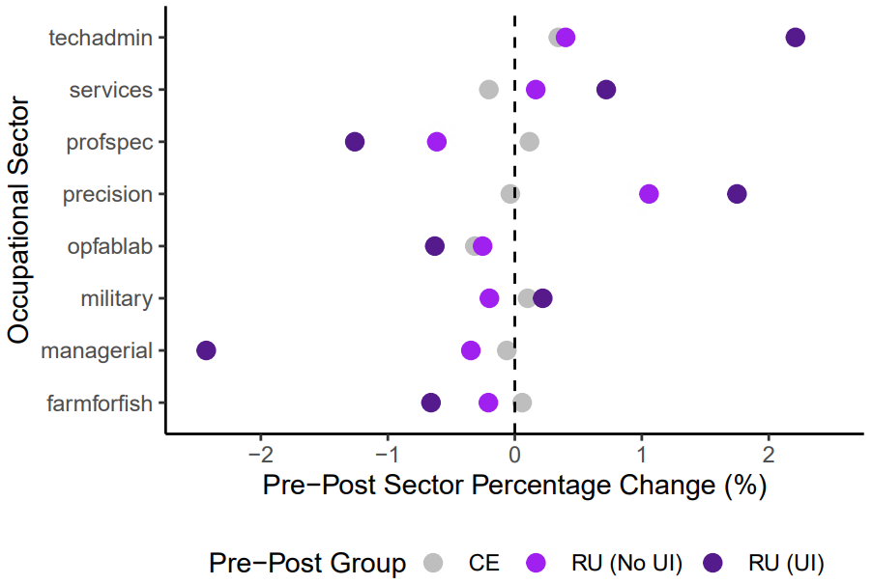
Preliminary Conclusions
Occupational Sector Key: ‘techadmin’ = Technical sales and admin support. ‘profspec’ = Professional specialty. ‘precision’ = Precision production, craft and repair. ‘opfablab’ = Operators, fabricators & laborers. ‘farmforfish’ = Farming, forestry, fishing.
Notes:
Other Points:
Those receiving UI remain unemployed for slightly longer on average than those not receiving UI (Mean (SD): No UI – 10.1 months (7.4), Yes UI – 11.4 months (8.1)).
Contrasting how groups change occupational sectors from ‘baseline’ to next employment via pre-post occupational sector absolute % changes:
Those consistently employed do not appreciably change sectors (Mean Absolute Change: 0.11%, SD: 0.12).
Those recently unemployed and not receiving UI change sectors more (Mean Absolute Change: 0.30%, SD: 0.30).
Those recently unemployed and receiving UI change sectors the most (Mean Absolute Change: 0.99%, SD: 0.81).
Contrasting these shifts in terms of the average EQ in sectors changed between:
Those consistently employed transition slightly into sectors with better EQ (Weighted Attributable Shift in Mean EQ: -0.001)
Those recently unemployed and not receiving UI transition slightly into sectors with worse EQ (Weighted Attributable Shift in Mean EQ: -0.002)
Those recently unemployed and receiving UI transition into sectors with even worse EQ, though still to a small extent (Weighted Attributable Shift in Mean EQ: -0.007)

